Slide 1
Background
* In a previous meeting the ACME Corp employee named Robert Loblaw with the job title "IT Manager", met with F5 employee Robin Mordasiewicz with a job title "Sales Engineer" who specializes in presenting and selling the F5 Distributed Cloud product. In the previous meeting Robert, who is responsible for maintaining the ACME Corp website https://www.acmecorp.com, explained to Robin that a security audit of the ACME Corp website revealed that there is currently an ongoing credential stuffing attack, which is leading to signifiant revenue loss and reputation damages.
* Robert also explained to Robin that the current architecture of the ACME Corp website is using the Akamai Content Delivery Network (CDN), with the additional subscription of the Akamai Web Application Firewall (WAF) product named Kona. Robert has learned that the Akamai Kona product does not protect against credential stuffing attacks, and that in order for Akamai to prevent credential stuffing attacks, Robert would need to purchase an additional Akamai product subscription named Akamai Bot Manager. Furthermore, Robert explained that the Akamai CDN load balances to origin servers that are hosted in AWS, and the origin servers that are in AWS which are hosting the website content are also connected to an on premisis datacenter using DirectConnect for database access, and that future plans to be considered are that the ACME Corp website will also expand to be running in both AWS and Azure.
* Robert has invited Robin to present a competetive Bot Protection product from F5 Distributed Cloud in the hopes that the F5 Distributed Cloud product is more fully featured and easier to use. Robert asked Robin to present the F5 Distributed Cloud Bot Protection functionality as well as the additional value add features that the F5 Distributed Cloud product can help with modernizing the ACME Corp website, specifically around multi-cloud networking.
* What follows is the content for an F5 Distributed Cloud presentation focusing on credential stuffing attacks, that Robin will present to Robert.

Slide 2

F5 Distributed Cloud
Robin Mordasiewicz – Sales Engineer

Slide 3
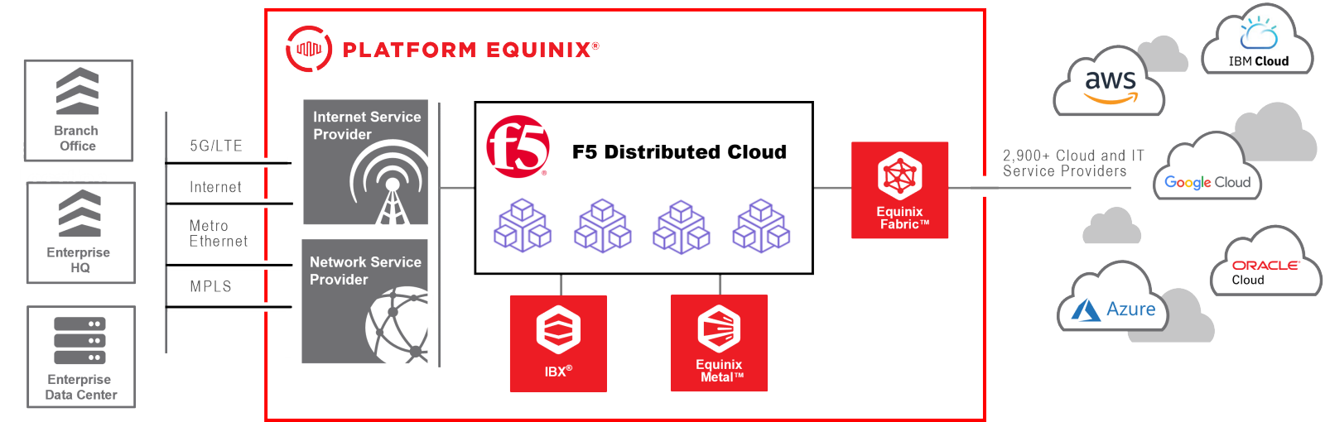

Slide 4

Locations
BGP Peers
Shape
Locations
BGP Peers
Linode
Bot Manager
Kona

Slide 5
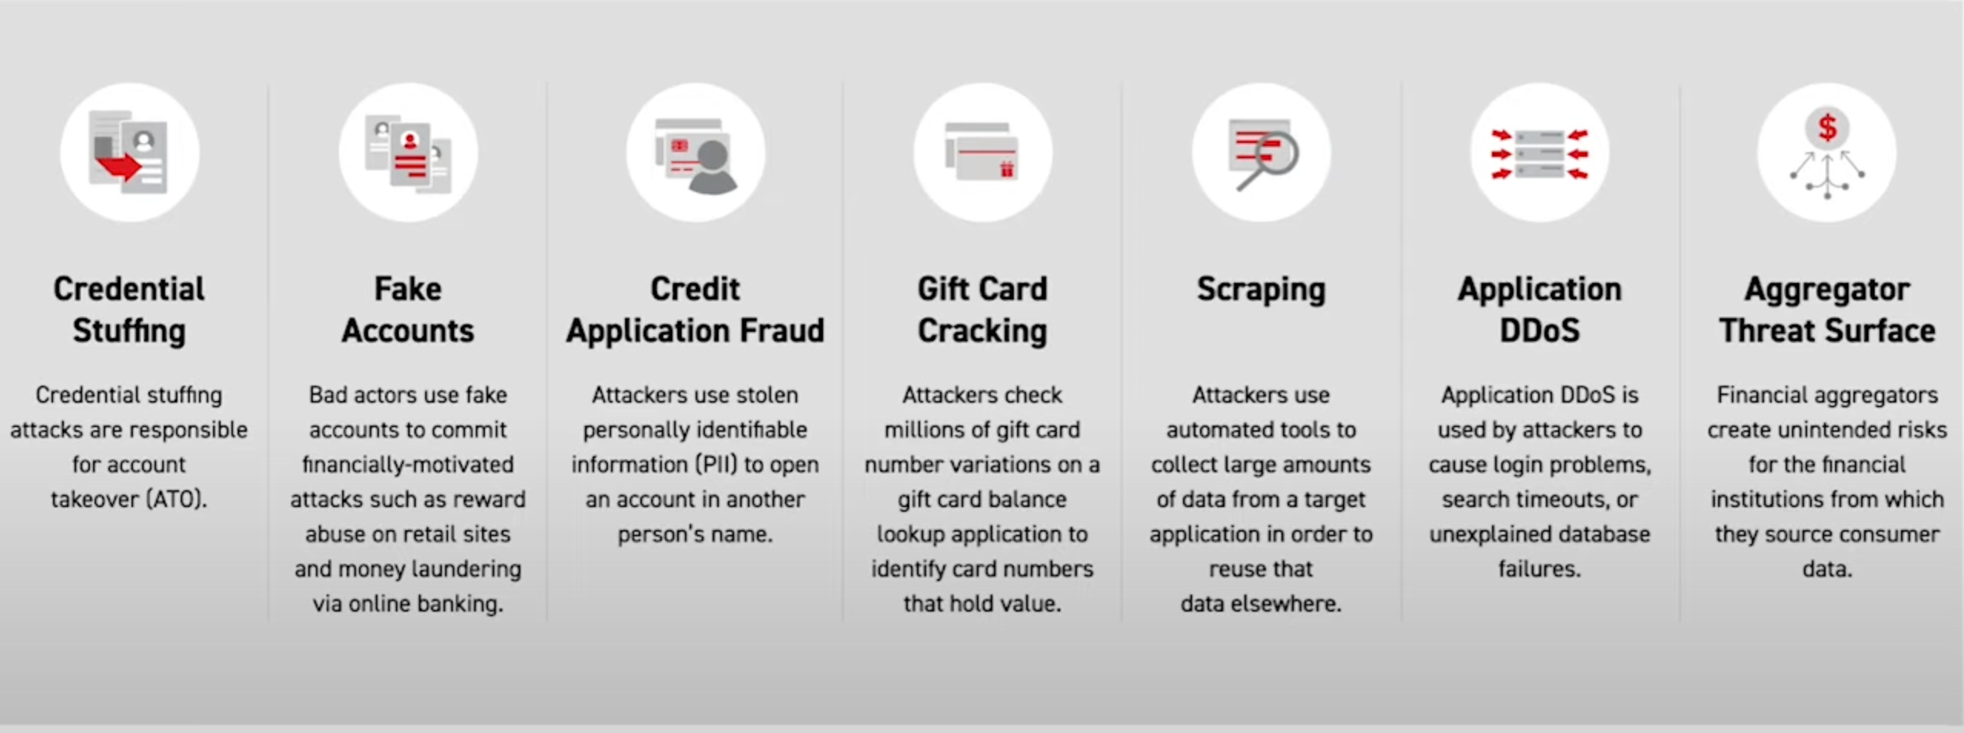
Bot Protection
Notes:
The F5 solution that I want to highlight today is the F5 Distributed Cloud Bot Protection specificslly to address your ongoing credential stuffing attack.
Credential stuffing abuses login forms to gain unauthorized access to customer accounts. These attacks typically leverage automated tools and compromised credentials, but often evolve to imitate human behavior or impersonate real customers, and the Bot Protection portfolio not only addresses credential stuffing, but credential stuffing is often the precursor to account takeover, fraud and other attacks.

Slide 6
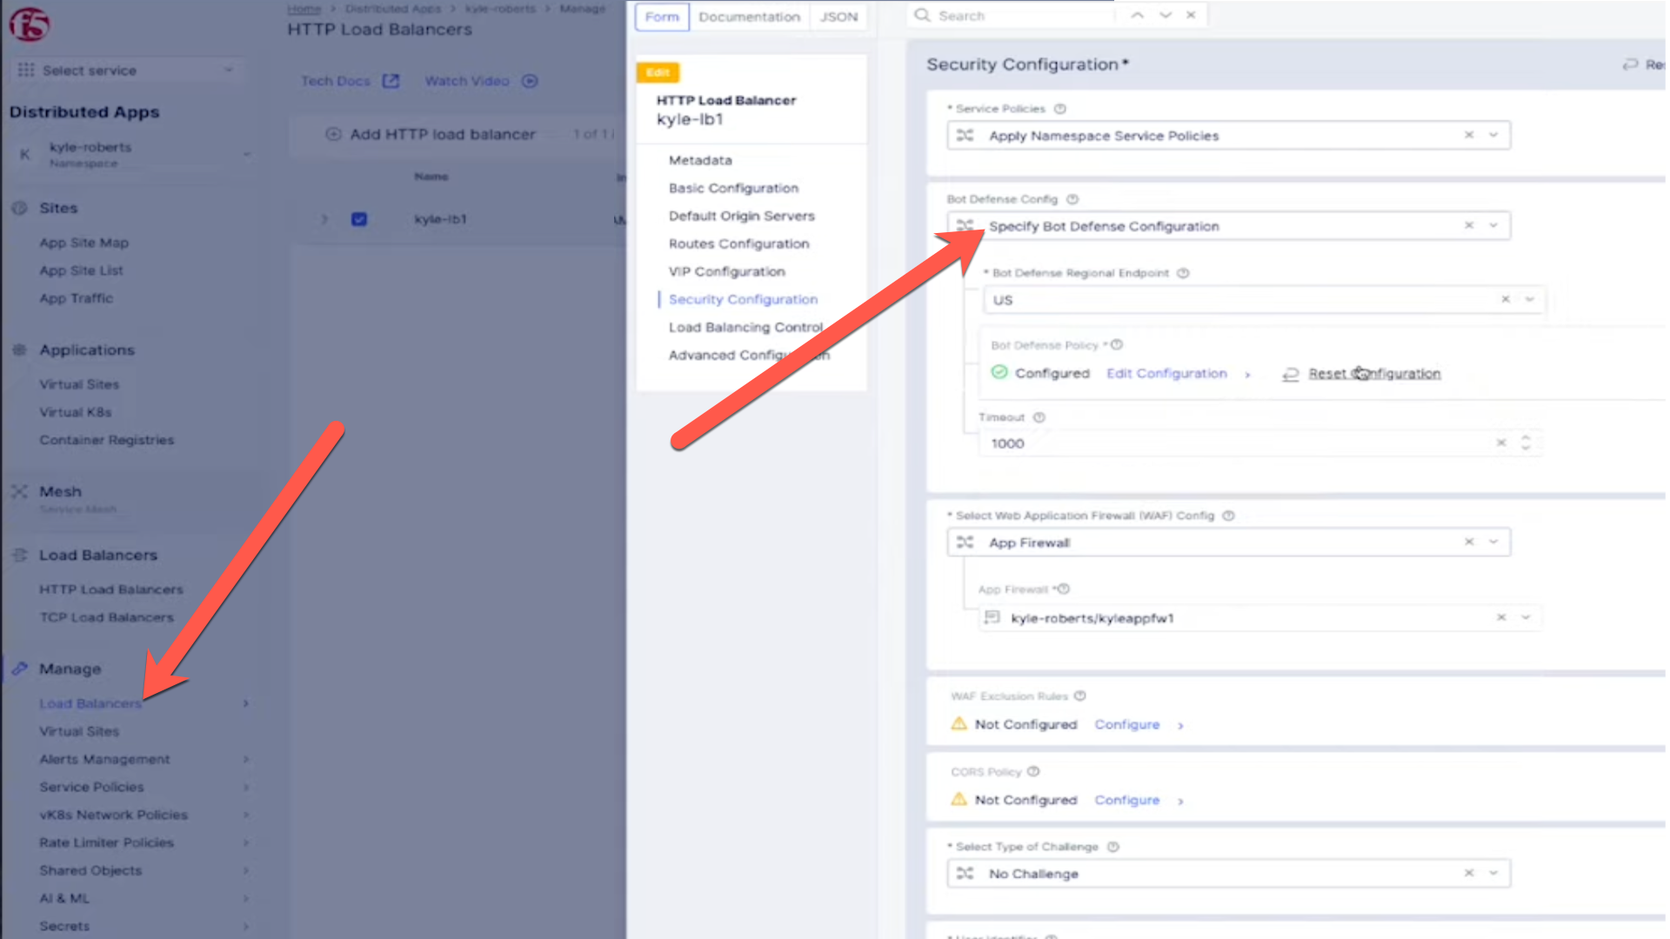
Enable Bot Defense

Slide 7
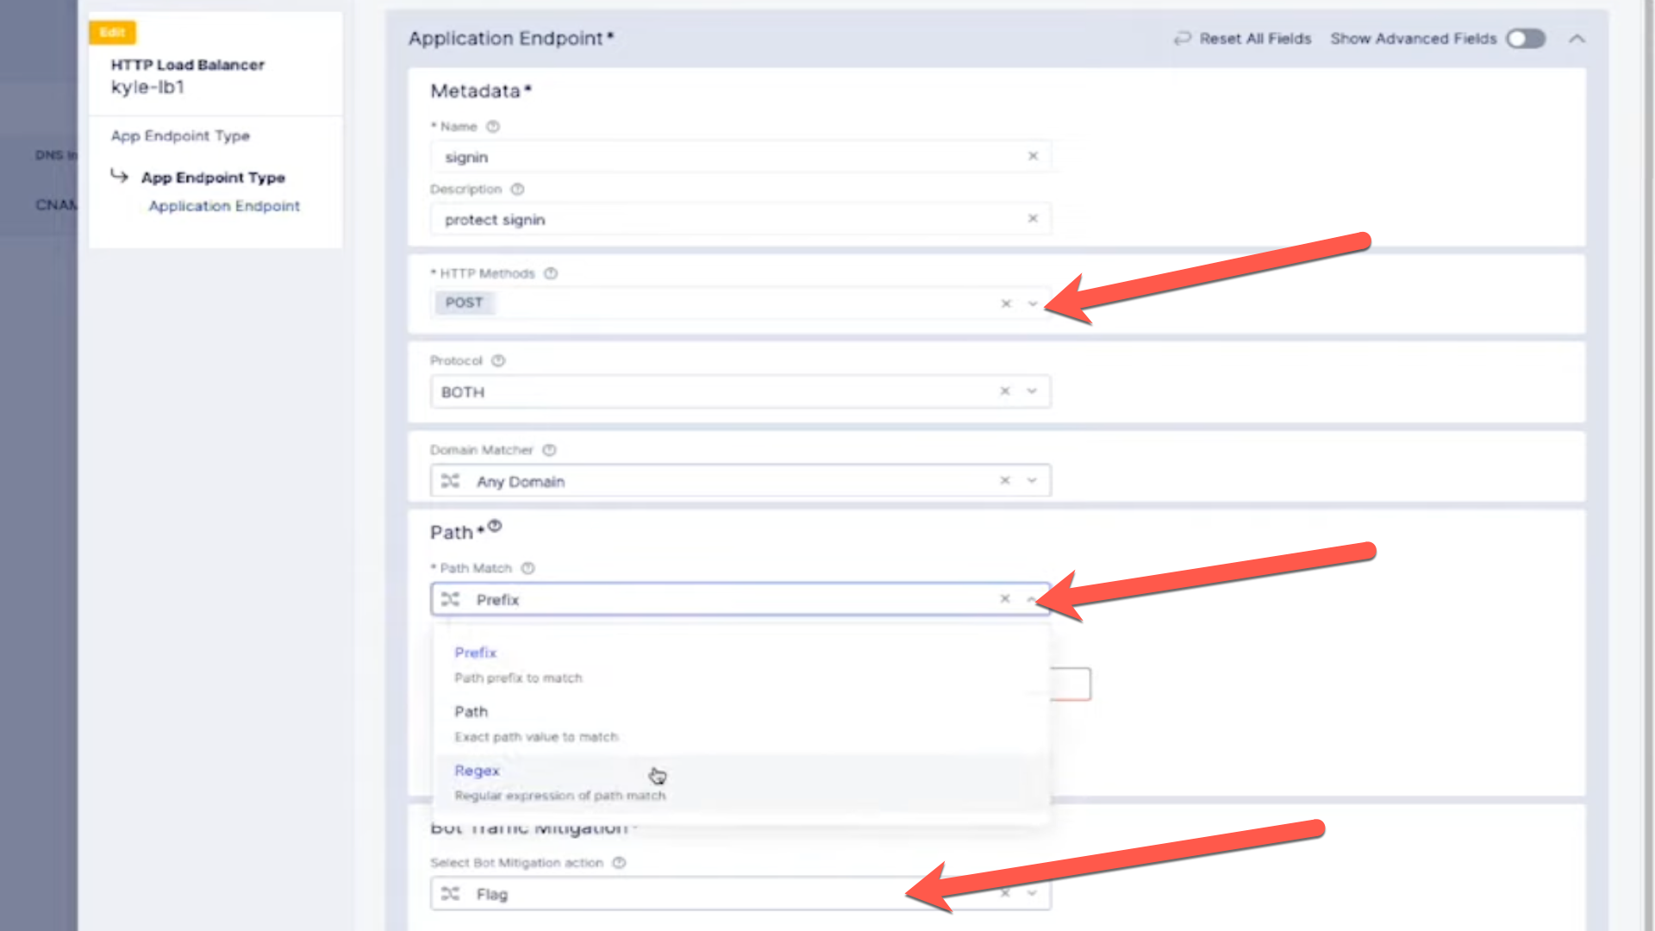
Create Bot Policy
Notes:
Create an app endpoint
Specify the method to POST on both protocolm on any domains, and for Path matching we can do prefix, regex or exact path, and for the actions you want to change it from Flag to Block.
There can enable carding against a payment page and credential stuffing against other pages.
From there we can specify how we want to inject the Javascript, which usually after the HEAD tag, but it can be in a script or after the title tag.

Slide 8
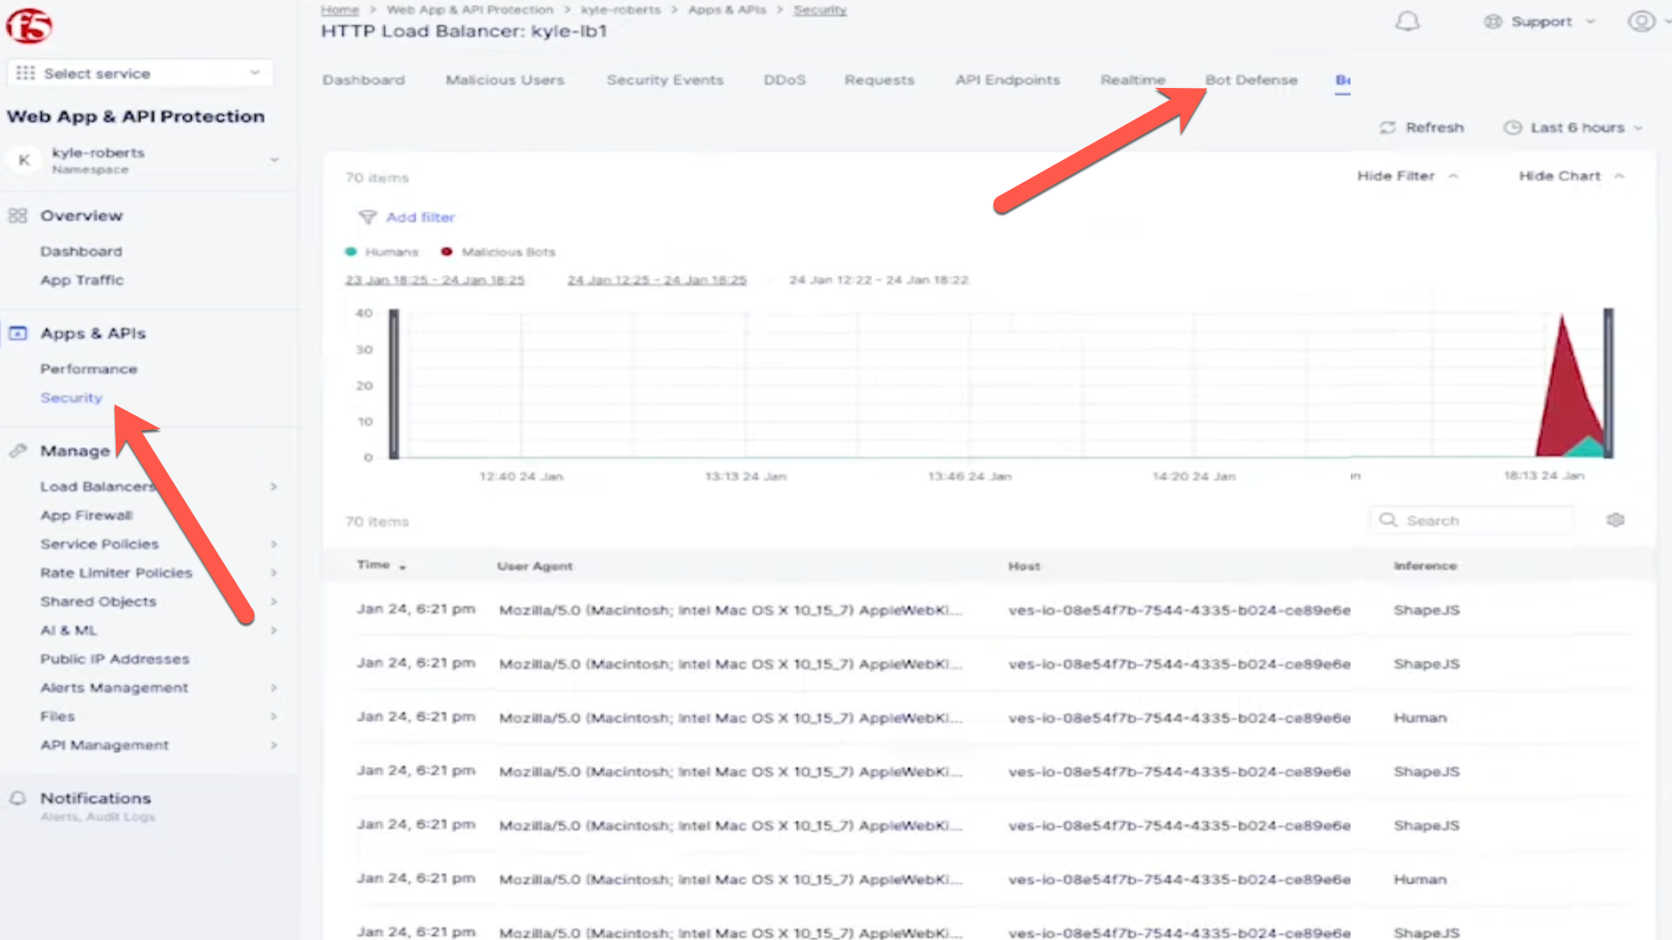
Bot Defense Reporting
Notes:
After launching an attack using a tool such as Selenium.
Launch the security dashboard where you will find all the analytics for your applications.
The ashvboard will show which endpoints are attacked the most, or which automations types are being used
You can customize the time period and filter for specifc attacks, and get detailed insight into

Slide 9
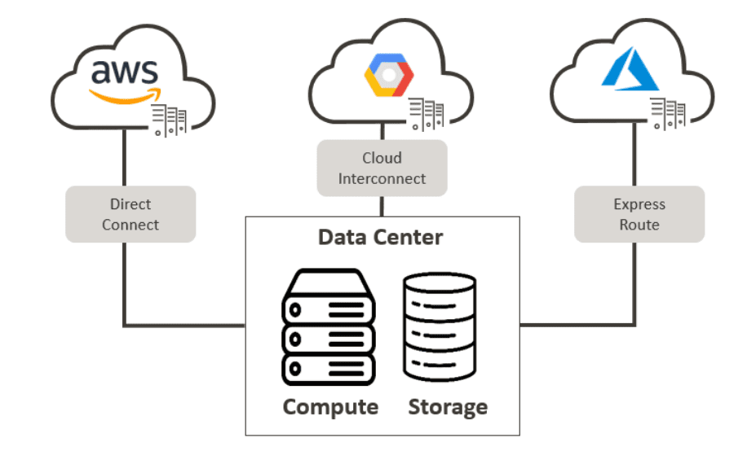

Slide 11
Shift-left Code Security

Slide 12





SECURE - SDLC
Building Security Into Software Development Cycle
FortiDevSec
CI/CD Trigger Scans
FortiDevSec
Manual Scans
Software
Development
Code Repository
Release!
Code Repository
Release!
CI/CD Tools
Check-in
Check-in
CI/CD Tools
Check-in
Check-in
-Build
-Test
- Deploy
-Build
-Test
- Deploy
Dev 1
Dev 2
Dev 3
Dev 4
Success
Failed
Fix
Notes:
DevSec can do automatic and manual type scans

